Slide 1
Tweets Classification
NLP: Text Classification
Karim Mohamed
Omar Merghany

Slide 2
Agenda
Introduction
Applications
Problem Statement
Dataset
Proposed Solution
Results
Classifiers’ Comparison
Discussion
How to Improve the Accuracy

Slide 3
Introduction
Text Classification is mainly about how to assign each text to a specific class or category

Slide 4
Applications
Spam and non-spam mail classification
Multiple classes classification

Slide 5

Problem Statement
Twitter has become as much of a news media as a social network, and much research has turned to analyzing its content for tracking real-world events, from politics to sports and natural disasters. Twitter users tweet their views in the form of short text messages.
Twitter generates 340+ million tweets per day, twitter is becoming a major source of information. This makes tweet classification a challenging problem for the Machine Learning researchers.
Twitter topic classification is classifying the tweets in to a set of predefined classes

Slide 6
Dataset
Train Dataset was created by fetching titles of different subreddit relating to 6 main following categories.
Test Dataset: We will use Twitter API (Application Programming Interface) to collect the tweets. We will download tweets and classify them to topics.
Technology
Business
Politics
Entertainment
Sports
Health

Slide 7
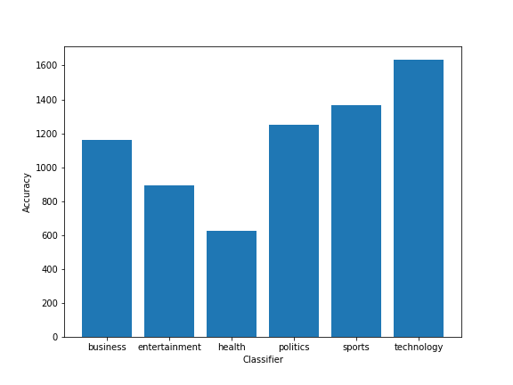
Dataset

Slide 8
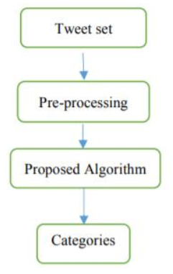
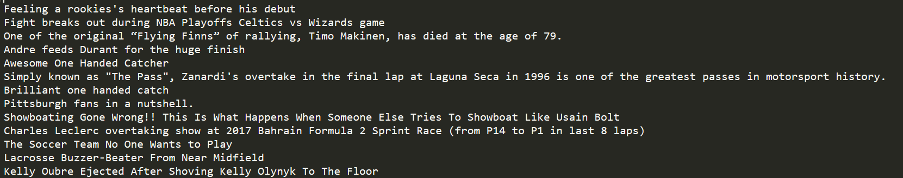
Proposed Solution
Machine Learning (SVM/ Naive Bayes)
Technology
Business
Politics
Entertainment
Sports
Health

Slide 9
Timeline
Finalize Preprocessing steps for the Tweets
Apply Naïve Bayes Classifier
Apply SVM

Slide 10
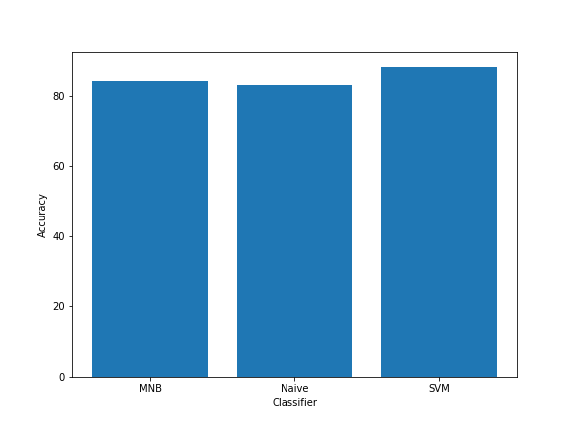
Classifiers’ Results
Naïve Bayes accuracy: 83.0
Linear SVM classifier accuracy: 88.0
MNB classifier accuracy: 84.0

Slide 11
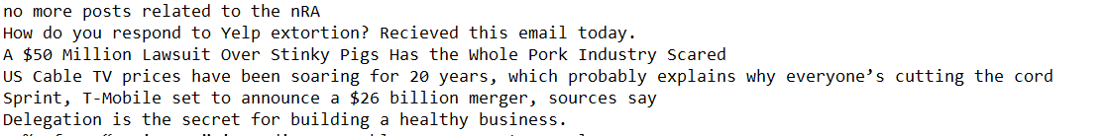
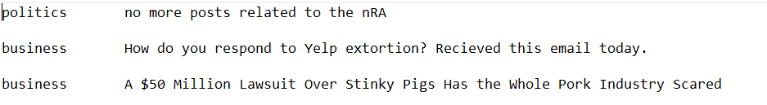
Test Set
Naive

Slide 12
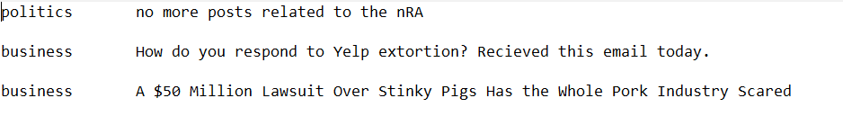
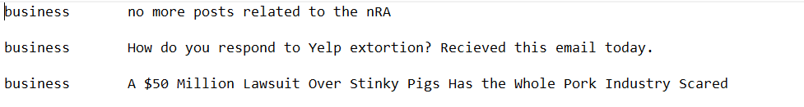
Test Set
MNB
SVM

Slide 13
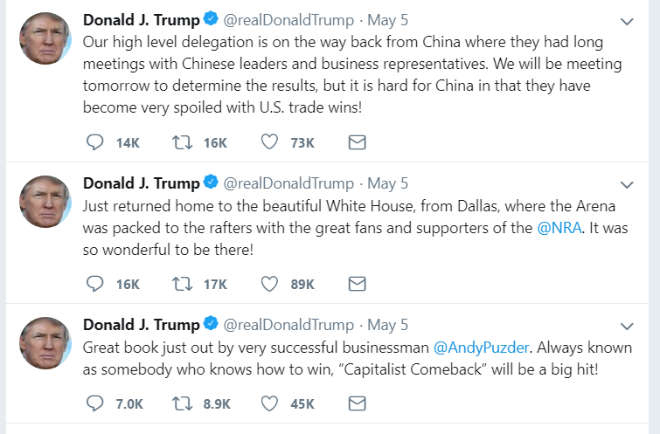
Test Sample

Slide 14
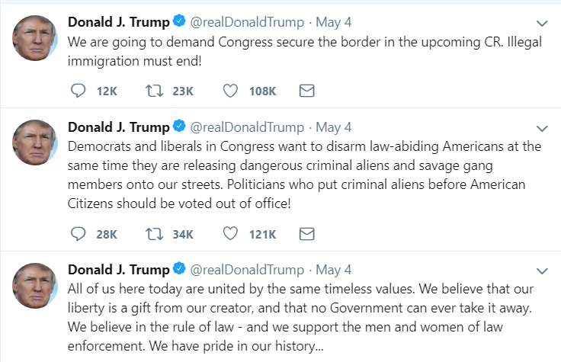
Test Sample

Slide 15
Naïve Bayes
Topic
Business | Our high level delegation is on the way back from China where they had long meetings with Chinese leaders and busin… https://t.co/HGTEQMJrPG JUST OUT: 3.9% Unemployment. 4% is Broken! In the meantime, WITCH HUNT!
Entertainment
Health
Politics | Just returned home to the beautiful White House, from Dallas, where the Arena was packed to the rafters with the gr… https://t.co/5jKrLoTcmD I want to thank all of our friends and patriots at the @NRA. We will never fail, and we will always protect your Se… https://t.co/4GCOdVeiqv We are going to demand Congress secure the border in the upcoming CR. Illegal immigration must end! Democrats and liberals in Congress want to disarm law-abiding Americans at the same time they are releasing dangero… https://t.co/Bm4XpXBswG Going to Dallas (the GREAT State of Texas) today. Leaving soon!

Slide 16
Naïve Bayes
Technology | All of us here today are united by the same timeless values. We believe that our liberty is a gift from our creator… https://t.co/JTq9VefLWZ
Sports | Thank you Cleveland, Ohio! https://t.co/ROEFRLY7jP Great book just out by very successful businessman @AndyPuzder. Always known as somebody who knows how to win, “Cap… https://t.co/EpbiTO9GHs

Slide 17
SVM
Topic
Business | Our high level delegation is on the way back from China where they had long meetings with Chinese leaders and busin… https://t.co/HGTEQMJrPG JUST OUT: 3.9% Unemployment. 4% is Broken! In the meantime, WITCH HUNT! I want to thank all of our friends and patriots at the @NRA. We will never fail, and we will always protect your Se… https://t.co/4GCOdVeiqv
Entertainment
Health | All of us here today are united by the same timeless values. We believe that our liberty is a gift from our creator… https://t.co/JTq9VefLWZ
Politics | Just returned home to the beautiful White House, from Dallas, where the Arena was packed to the rafters with the gr… https://t.co/5jKrLoTcmD We are going to demand Congress secure the border in the upcoming CR. Illegal immigration must end! Democrats and liberals in Congress want to disarm law-abiding Americans at the same time they are releasing dangero… https://t.co/Bm4XpXBswG

Slide 18
SVM
Technology | Going to Dallas (the GREAT State of Texas) today. Leaving soon!
Sports | Thank you Cleveland, Ohio! https://t.co/ROEFRLY7jP Great book just out by very successful businessman @AndyPuzder. Always known as somebody who knows how to win, “Cap… https://t.co/EpbiTO9GHs

Slide 19
MNB
Topic
Business | Our high level delegation is on the way back from China where they had long meetings with Chinese leaders and busin… https://t.co/HGTEQMJrPG JUST OUT: 3.9% Unemployment. 4% is Broken! In the meantime, WITCH HUNT!
Entertainment
Health
Politics | Just returned home to the beautiful White House, from Dallas, where the Arena was packed to the rafters with the gr… https://t.co/5jKrLoTcmD We are going to demand Congress secure the border in the upcoming CR. Illegal immigration must end! Democrats and liberals in Congress want to disarm law-abiding Americans at the same time they are releasing dangero… https://t.co/Bm4XpXBswG Great book just out by very successful businessman @AndyPuzder. Always known as somebody who knows how to win, “Cap… https://t.co/EpbiTO9GHs I want to thank all of our friends and patriots at the @NRA. We will never fail, and we will always protect your Se… https://t.co/4GCOdVeiqv Going to Dallas (the GREAT State of Texas) today. Leaving soon!

Slide 20
MNB
Technology | All of us here today are united by the same timeless values. We believe that our liberty is a gift from our creator… https://t.co/JTq9VefLWZ
Sports | Thank you Cleveland, Ohio! https://t.co/ROEFRLY7jP

Slide 21
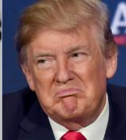
Discussion
Semantic and Hidden Meaning
Domain of the training data was different than the test
Trump is bad example for testing xD

Slide 22
How to improve Accuracy
Consider Using Neural Nets to consider the context and try to understand the semantics
Add Lexicon for

